Slide 1
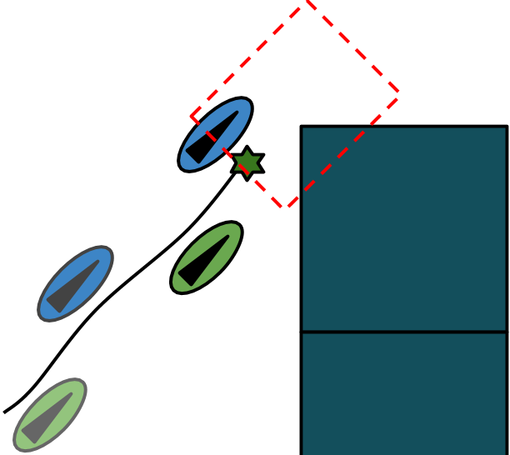
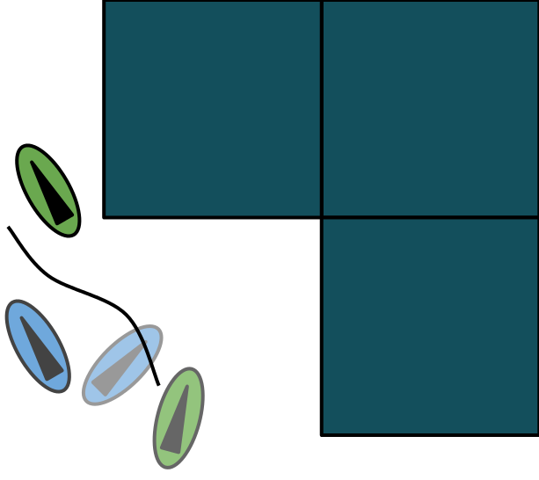
Robust Space-Time Footsteps for Agent-Based Steering
Picture
By
Glen Berseth¹, Mubbasir Kapadia², Petros Faloutsos³
University of British Columbia¹, Rutgers University², York University³
Notes:
Have 15 minutes for talk? 12 minutes for presentation 3 minutes for question?

Slide 2


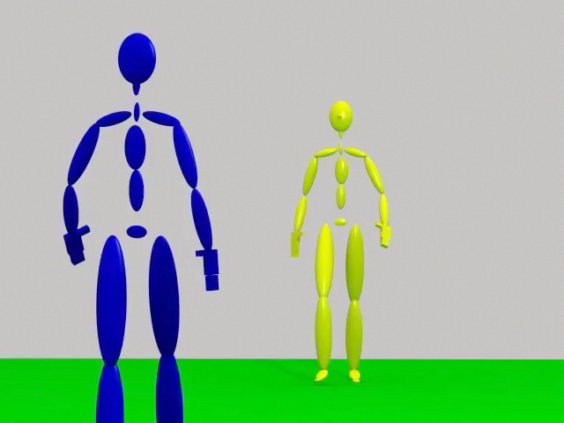
Interface between steering and motion synthesis
Simple Sliding Disk
Position
Velocity
No information about limbs
Notes:
Discs
To large, bad crowd packing
Two small, limb collisions

Slide 3
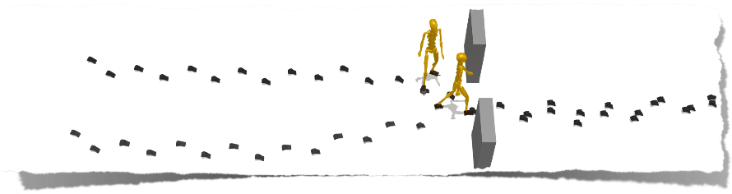
Goals
Better interface between steering and motion synthesis
Sufficiently detailed information for motion synthesis
Efficient space-time planning
Heterogeneous agents
Better qualitative performance

Slide 4
Contributions:
Geometric pruning of search space
Search uses randomized step directions and times
New types of footsteps (In-place turning)
Benefits:
5x performance increase
Improved stability and local minima avoidance
Elimination of certain deadlocking configurations

Slide 5
Related Work
Footstep-based steering
Robotics [Lots]
Animation [van Basten and Egges 2010, Singh et al. 2011]
Notes:
The work that is related to this research

Slide 6
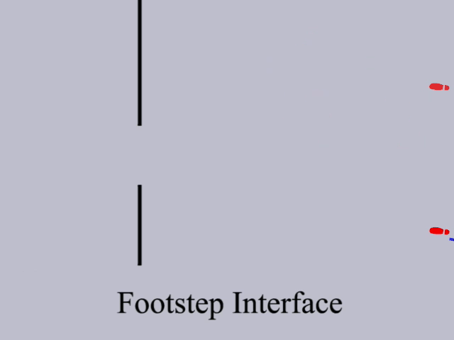
Example

Slide 7
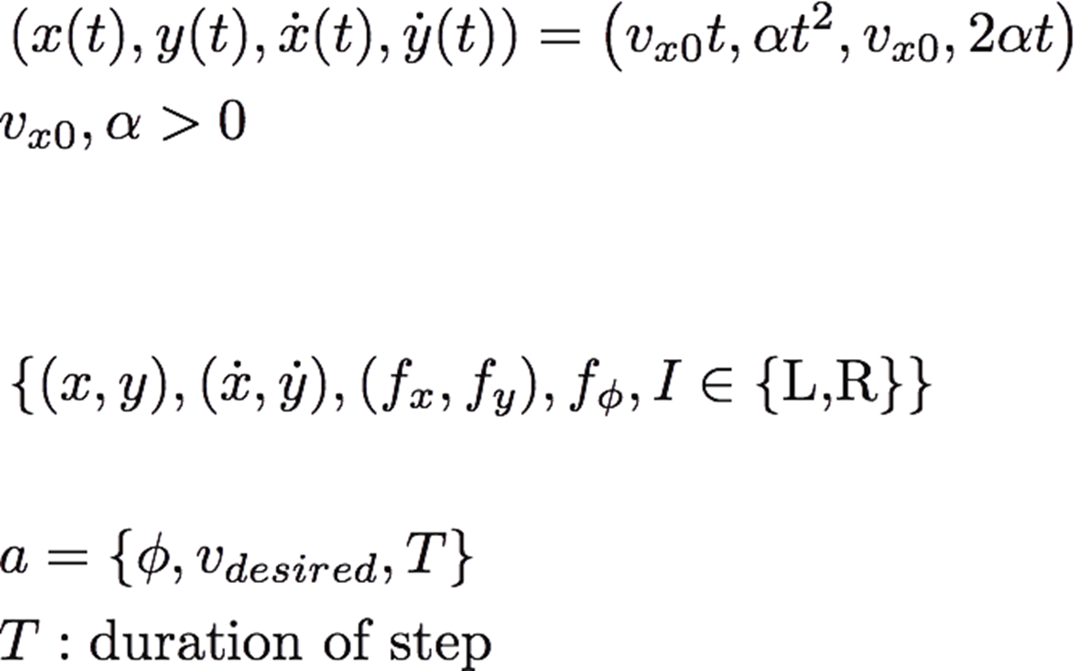
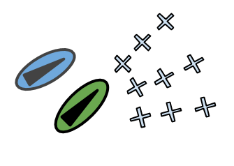

Footstep State Space
Footstep State:
{COM Position, COM Velocity, foot position, foot orientation, foot $∈$ {Left, Right}}
Footstep Action:
Notes:
{Com Position, COM velocity, current foot position, current foot orientation, current foot}

Slide 8
Motion Planner
Near-optimal finite horizon best first search
Cost function:
Maintaining certain speed
Changing momentum
Heuristic estimate:
Estimates the number of steps to the goal and then computes the associated energy cost
Notes:
Regions are important, don’t use goal location

Slide 9
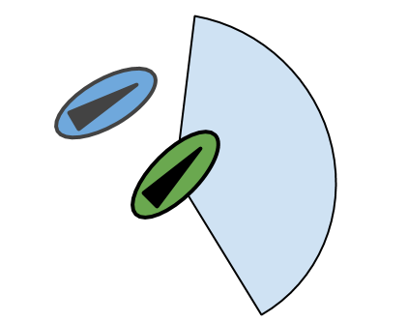
Successor State Generation
Randomized, continuous
Ad-hoc, discrete
Possible successor states for right foot
Notes:
Ad-hoc methods are susceptible to complex configurations

Slide 10
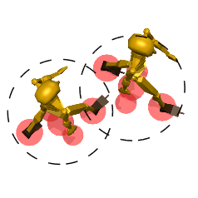
Dynamic Collision Model
Notes:
Dynamic collision model is complex

Slide 11
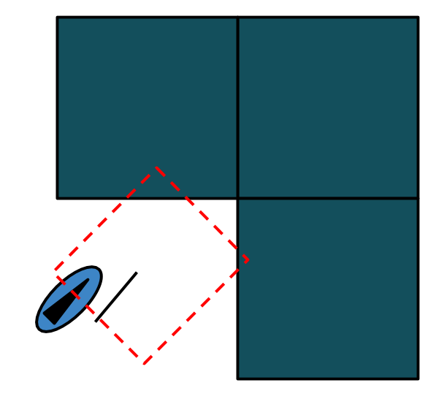
Geometric Validation
End of finite horizon plan
Initial placement

Slide 12
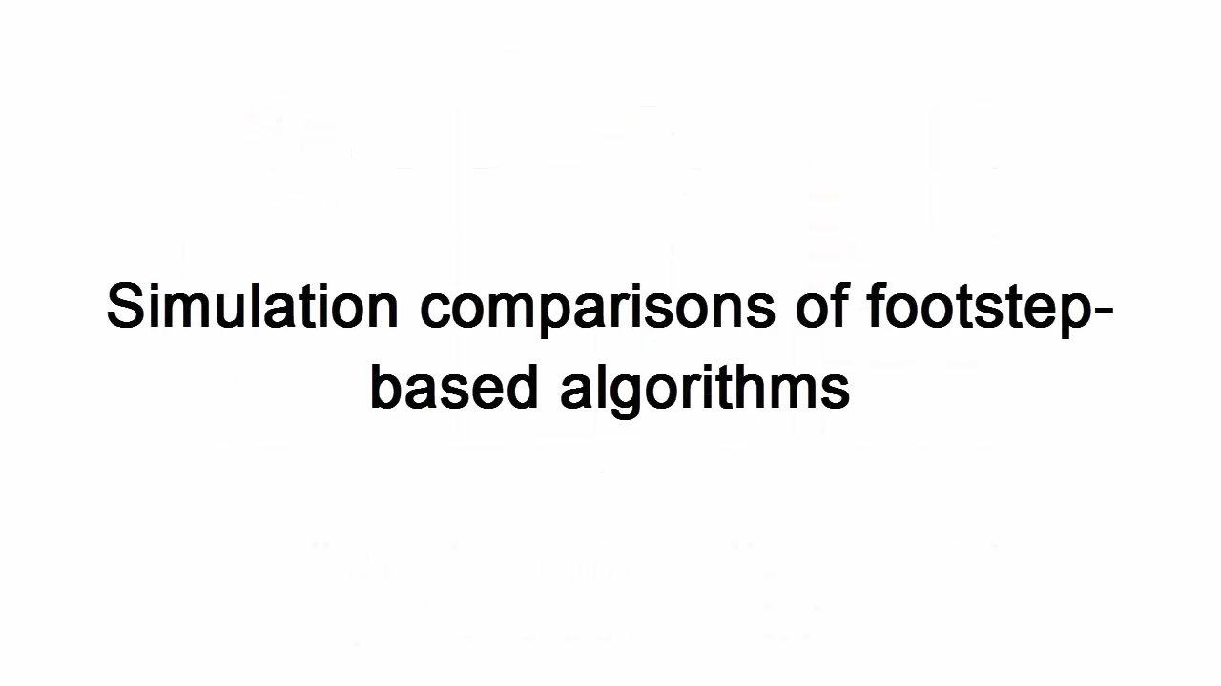

Examples

Slide 13
Analysis metrics:
Quality:
Complete:
Reached target location
Solved:
Reached target location without collision
Efficiency:
SimTime:
Time to finish simulation

Slide 14
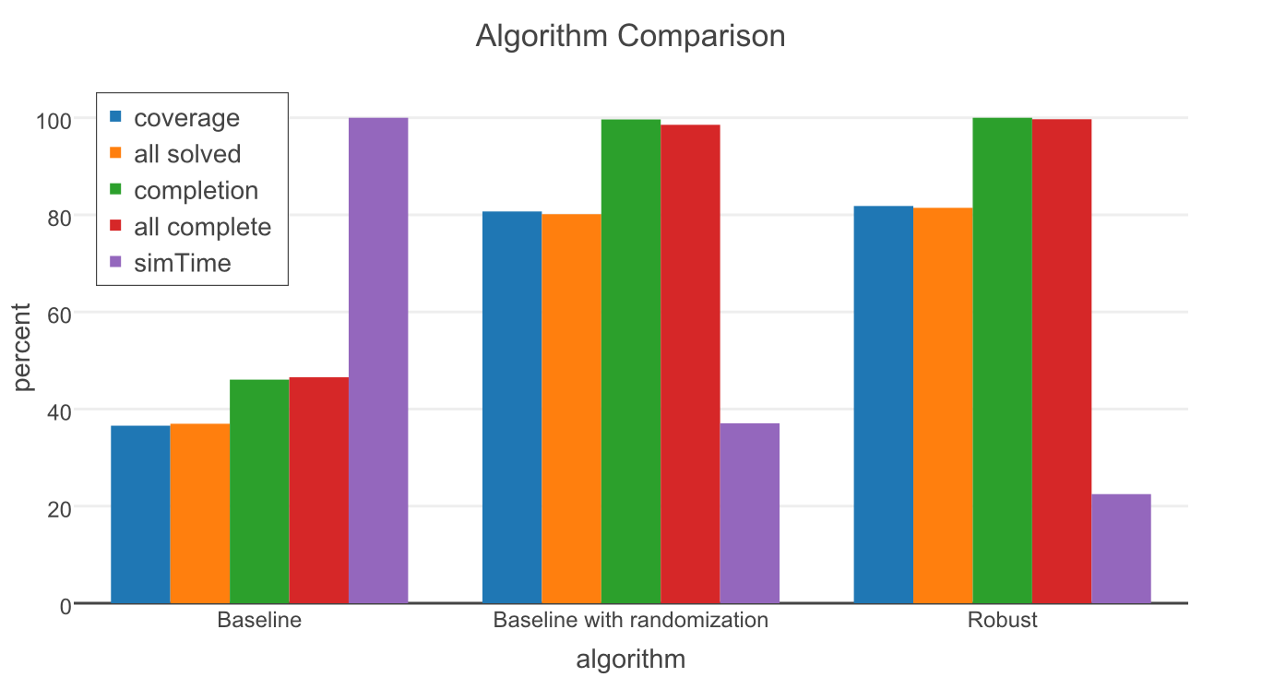
Analysis
99.7% completion
[Singh et al. 11]
Notes:
Describe metrics

Slide 15
Questions?
Robust Space-Time Footsteps for Agent-Based Steering
By
Glen Berseth¹, Mubbasir Kapadia², Petros Faloutsos³
University of British Columbia¹, Rutgers University², York University³

Slide 16
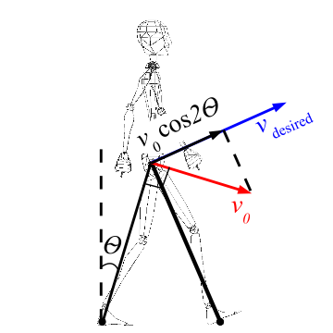
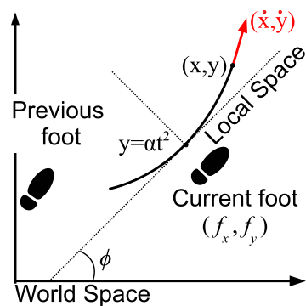
Footstep Model

Slide 17
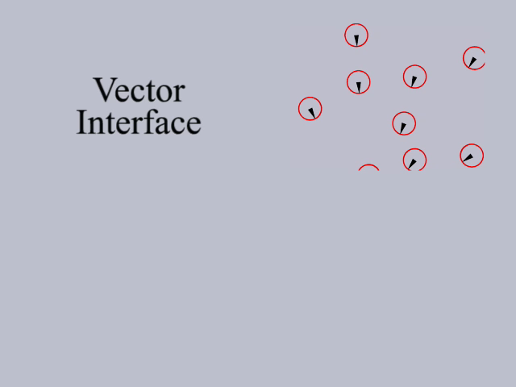
Sliding Disk Issues
Has fixed collision boundaries
Provides no contact points
Few locomotion constraints (turning radius, sharp changes in direction)
No space time planning

